Slide 1

LET US C
BY YASHAVANT KANETKAR
CH 11 Q[C]
CH 11 Q[A]
CH 11 Q[B]
CHAPTER 11 SOLUTIONS
DATA TYPES REVISITED

Slide 2
CHAPTER 11 SOLUTIONS
DATA TYPES REVISITED
Q[A] What will be the output of the following programs:
CH 11 Q[A]
(a)
(b)
#include <stdio.h>
int main()
{
int i;
for (i = 0 ; i <= 50000; i++)
printf("%d\n", i);
return 0;
}
#include <stdio.h>
int main()
{
float a = 13.5;
double b = 13.5;
printf("%f %f\n", a, b);
return 0;
}
(c)
CH 11 Q[C]
CH 11 Q[B]
(d)
(e)
DEAR CODING
(f)
(g)
(h)
BOOK: LET US C
BY YASHAVANT KANETKAR

Slide 3
CHAPTER 11 SOLUTIONS
DATA TYPES REVISITED
(a)
#include <stdio.h>
int main()
{
int i;
for (i = 0 ; i <= 50000; i++)
printf("%d\n", i);
return 0;
}
0
1
…
5000
👩‍💻 Output:
CH 11 Q[A](a)
DEAR CODING
BOOK: LET US C
BY YASHAVANT KANETKAR

Slide 4

CHAPTER 11 SOLUTIONS
DATA TYPES REVISITED
(b)
#include <stdio.h>
int main()
{
float a = 13.5;
double b = 13.5;
printf("%f %f\n", a, b);
return 0;
}
👩‍💻 Output:
CH 11 Q[A](b)
DEAR CODING
BOOK: LET US C
BY YASHAVANT KANETKAR

Slide 5
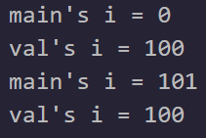
CHAPTER 11 SOLUTIONS
DATA TYPES REVISITED
(c)
#include <stdio.h>
int i = 0;
void val();
int main()
{
printf("main's i = %d\n", i);
i++;
val();
printf("main's i = %d\n", i);
val();
return 0;
}
void val()
{
i = 100;
printf("val's i = %d\n", i);
i++;
}
👩‍💻 Output:
CH 11 Q[A](c)
DEAR CODING
BOOK: LET US C
BY YASHAVANT KANETKAR

Slide 6

CHAPTER 11 SOLUTIONS
DATA TYPES REVISITED
(d)
#include <stdio.h>
int f(int);
int g(int);
int main()
{
int x, y, s = 2;
s *= 3;
y = f(s);
x = g(s);
printf("%d %d %d\n", s, y, x);
return 0;
}
int t = 8;
int t = 8;
int f ( int a)
{
a += -5;
t = 4;
return ( a + t );
}
int g (int a) {
a = 1;
t += a;
return ( a + t);
}
CH 11 Q[A](d)
DEAR CODING
👩‍💻 Output:
BOOK: LET US C
BY YASHAVANT KANETKAR

Slide 7
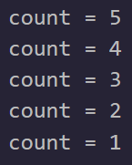
CHAPTER 11 SOLUTIONS
DATA TYPES REVISITED
(e)
#include <stdio.h>
int main()
{
static int count = 5;
printf("count = %d\n", count--);
if (count != 0)
main();
return 0;
}
👩‍💻 Output:
CH 11 Q[A](e)
DEAR CODING
BOOK: LET US C
BY YASHAVANT KANETKAR

Slide 8

CHAPTER 11 SOLUTIONS
DATA TYPES REVISITED
(f)
#include <stdio.h>
int g(int);
int main()
{
int i, j;
for (i = 1; i < 5; i++)
{
j = g(i);
printf("%d\n", j);
}
return 0;
}
int g(int x)
{
static int v = 1;
int b = 3;
v += x;
return (v + x + b);
}
👩‍💻 Output:
CH 11 Q[A](f)
i = 1, 2, 3, 4
g(1) | g(2) | g(3) | g(4)
X = 1 | X = 2 | X = 3 | X = 4
v = 1 | V = 2 | V = 4 | V = 7
b = 3 | b = 3 | b = 3 | b = 3
V = 2 | V = 4 | V = 7 | V = 11
return 6 | return 9 | return 13 | return 18
DEAR CODING
BOOK: LET US C
BY YASHAVANT KANETKAR

Slide 9

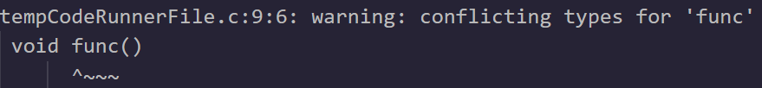
CHAPTER 11 SOLUTIONS
DATA TYPES REVISITED
(g)
#include <stdio.h>
int main()
{
func();
func();
return 0;
}
void func()
{
auto int i = 0;
register int j = 0;
static int k = 0;
i++; j++; k++;
printf("%d %d %d\n", i, j, k);
}
👩‍💻 Output:
CH 11 Q[A](g)
DEAR CODING
BOOK: LET US C
BY YASHAVANT KANETKAR

Slide 10

CHAPTER 11 SOLUTIONS
DATA TYPES REVISITED
(h)
#include <stdio.h>
Int x = 10;
int main()
{
int x = 20;
{
int x = 30;
printf("%d\n",x);
}
printf("%d\n",x);
return 0;
}
👩‍💻 Output:
CH 11 Q[A](h)
DEAR CODING
BOOK: LET US C
BY YASHAVANT KANETKAR

Slide 11
CHAPTER 11 SOLUTIONS
DATA TYPES REVISITED
Q[B] Point out the errors, if any, in the following C programs:
CH 11 Q[B]
(a)
(b)
(c)
#include <stdio.h>
int main()
{
long num;
num = 2;
printf("%d\n", num);
return 0;
}
#include <stdio.h>
int main()
{
char ch = 200;
printf("%d\n", ch);
return 0;
}
(d)
(e)
DEAR CODING
BOOK: LET US C
BY YASHAVANT KANETKAR

Slide 12

CHAPTER 11 SOLUTIONS
DATA TYPES REVISITED
(a)
#include <stdio.h>
int main()
{
long num;
num = 2;
printf("%d\n", num);
return 0;
}
CH 11 Q[B](a)
✅ No error!
👩‍💻 Output:
DEAR CODING
BOOK: LET US C
BY YASHAVANT KANETKAR

Slide 13

CHAPTER 11 SOLUTIONS
DATA TYPES REVISITED
(b)
👩‍💻 Output:
#include <stdio.h>
int main()
{
char ch = 200;
printf("%d\n", ch);
return 0;
}
CH 11 Q[B](b)
✍️ A char variable is a single byte, which can hold integer values from -128 to 127 or unsigned values from 0 to 255, depending on whether it is signed or unsigned.
✍️ The variable ch is declared as a char, and a char cannot take a value bigger than +127. Hence when value of ch exceeds +127, an appropriate value from the other side of the range is picked up and is stored in ch. This value in this case happens to be -56.
DEAR CODING
BOOK: LET US C
BY YASHAVANT KANETKAR

Slide 14
CHAPTER 11 SOLUTIONS
DATA TYPES REVISITED
(a)
👩‍💻 Output:
#include <stdio.h>
int main()
{
char ch = 200;
printf("%d\n", ch);
return 0;
}
CH 11 Q[B](a)
✍️ A char variable is a single byte, which can hold integer values from -128 to 127 or unsigned values from 0 to 255, depending on whether it is signed or unsigned.
✍️ The variable ch is declared as a char, and a char cannot take a value bigger than +127. Hence when value of ch exceeds +127, an appropriate value from the other side of the range is picked up and is stored in ch. This value in this case happens to be -56.
DEAR CODING
BOOK: LET US C
BY YASHAVANT KANETKAR

Slide 15

CHAPTER 11 SOLUTIONS
DATA TYPES REVISITED
(c)
#include <stdio.h>
int main()
{
unsigned a = 25;
long unsigned b = 251;
printf("%lu %u\n", a, b);
return 0;
}
👩‍💻 Output:
CH 11 Q[B](c)
DEAR CODING
BOOK: LET US C
BY YASHAVANT KANETKAR

Slide 16
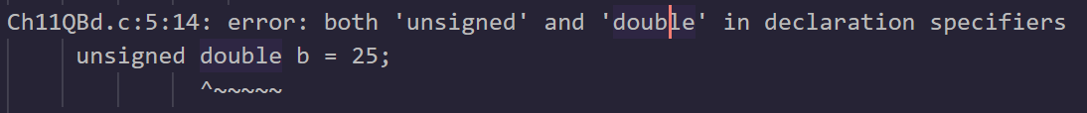
CHAPTER 11 SOLUTIONS
DATA TYPES REVISITED
(a)
#include <stdio.h>
int main()
{
long float a = 25.345e454;
unsigned double b = 25;
printf("%lf %d\n", a, b);
return 0;
}
✍️ The data types long float and unsigned double are not valid in C. The correct data types for floating-point numbers are float, double, and long double.
CH 11 Q[B](a)
DEAR CODING
BOOK: LET US C
BY YASHAVANT KANETKAR

Slide 17

CHAPTER 11 SOLUTIONS
DATA TYPES REVISITED
(a)
// CORRECT VERSION
#include <stdio.h>
int main() {
double a = 25.345e454;
unsigned int b = 25;
printf("%lf %u\n", a, b);
return 0;
}
👩‍💻 Output:
CH 11 Q[B](a)
DEAR CODING
BOOK: LET US C
BY YASHAVANT KANETKAR

Slide 18

CHAPTER 11 SOLUTIONS
DATA TYPES REVISITED
(d)
#include <stdio.h>
static int y;
int main()
{
static int z;
printf("%d %d\n", y, z);
return 0;
}
👩‍💻 Output:
CH 11 Q[B](d)
DEAR CODING
BOOK: LET US C
BY YASHAVANT KANETKAR

Slide 19
CHAPTER 11 SOLUTIONS
DATA TYPES REVISITED
[C] State whether the following statements are True or False:
(a) Storage for a register storage class variable is allocated each time the control reaches the block in which it is present. True
(b) An extern storage class variable is not available to the functions that precede its definition, unless the variable is explicitly declared in these functions. True
(c) The value of an automatic storage class variable persists between various function invocations. False
CH 11 Q[C]
DEAR CODING
BOOK: LET US C
BY YASHAVANT KANETKAR

Slide 20
CHAPTER 11 SOLUTIONS
DATA TYPES REVISITED
[C] State whether the following statements are True or False:
(d) If the CPU registers are not available, the register storage class variables are treated as static storage class variables. False
(e) The register storage class variables cannot hold float values. False
(f) If we try to use register storage class for a float variable the compiler will report an error message. False
CH 11 Q[C]
DEAR CODING
BOOK: LET US C
BY YASHAVANT KANETKAR

Slide 21
CHAPTER 11 SOLUTIONS
DATA TYPES REVISITED
[C] State whether the following statements are True or False:
(g) If the variable x is defined outside all functions and a variable x is also defined as a local variable of some function, then the global variable gets preference over the local variable. False
(h) The default value for automatic variable is zero. False
(i) The life of static variable is till the control remains within the block in which it is defined. False
CH 11 Q[C]
DEAR CODING
BOOK: LET US C
BY YASHAVANT KANETKAR

Slide 22
CHAPTER 11 SOLUTIONS
DATA TYPES REVISITED
[C] State whether the following statements are True or False:
(j) If a global variable is to be defined, then the extern keyword is
necessary in its declaration. False
(k) The address of register variable is not accessible. True
(l) A variable that is defined outside all functions can also have a static storage class. True
(m) One variable can have multiple storage classes. True
CH 11 Q[C]
DEAR CODING
BOOK: LET US C
BY YASHAVANT KANETKAR

Slide 23
LET US C
BY YASHAVANT KANETKAR
CH 12 Q[B]
CH 12 Q[C]
CH 12 Q[A]
CHAPTER 12 SOLUTIONS
THE C PREPROCESSOR

Slide 24


🔴Let me create amazing coding tutorials for you forever!🙂
👇👇👇👇👇👇👇👇👇👇👇👇👇👇👇👇👇👇
👉 SUBSCRIBE 🤛
CH 12 Q[C]
CH 12 Q[A]
CHAPTER 12 SOLUTIONS
THE C PREPROCESSOR
CH 12 Q[B]
Thanks for your valuable time!

Slide 25

CHAPTER 11 SOLUTIONS
DATA TYPES REVISITED
(a)
#include <stdio.h>
int main()
{
unsigned a = 25;
long unsigned b = 251;
printf("%lu %u\n", a, b);
return 0;
}
a == b
✅ No error!
CH 11 Q[B](a)
👩‍💻 Output:
✍️ 12.52 gets assigned to a so the if is now reduced to if ( a ) or if ( 12.52 ). Since 12.52 isn’t non zero, it is true hence printf() gets executed.
DEAR CODING
BOOK: LET US C
BY YASHAVANT KANETKAR

Slide 26
CHAPTER 11 SOLUTIONS
DATA TYPES REVISITED
(d)
#include <stdio.h>
int main()
{
int x = 10;
if (x >= 2) then
printf("%d\n", x);
return 0;
}
CH 11 Q[B](d)
❌
ERROR!
DEAR CODING
✍️ There is no keyword "then“ in C & no variable defined here in program as well.
BOOK: LET US C
BY YASHAVANT KANETKAR

Slide 27

CHAPTER 11 SOLUTIONS
DATA TYPES REVISITED
(d)
#include <stdio.h>
int main()
{
int x = 10;
if (x >= 2)
printf("%d\n", x);
return 0;
}
CH 11 Q[B](d)
DEAR CODING
BOOK: LET US C
BY YASHAVANT KANETKAR

Slide 28
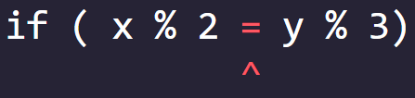
CHAPTER 11 SOLUTIONS
DATA TYPES REVISITED
(e)
#include <stdio.h>
int main()
{
int x = 10, y = 15;
if ( x % 2 = y % 11)
printf("Carpathians\n");
return 0;
}
❌ ERROR!
CH 11 Q[B](e)
✍️ C allows only one variable on left hand side of “=“ assignment operator.
DEAR CODING
BOOK: LET US C
BY YASHAVANT KANETKAR

Slide 29
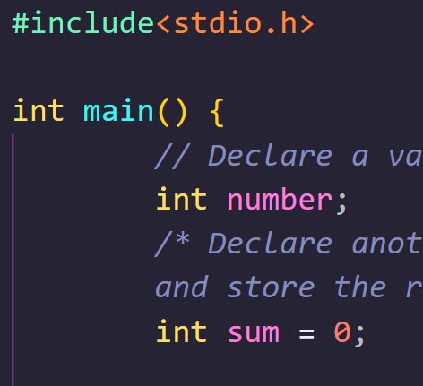
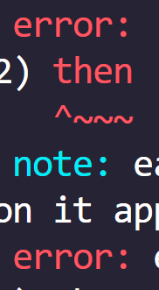

DEAR CODING

